Slide 1
Fiscal policy and sovereign debt crisis in the EU
Francesco Passarelli
University of Teramo and Bocconi University

Slide 2
The free-rider problem
In a currency union governments have strong incentives to bail out a country that borrows excessively
Two ways to solve this:
1. The Stability Pact
2. The no-bailout clause

Slide 3
EMU design
Treaty (art.104): “member States shall avoid excessive governments deficits”
below 3%
and debt below 60% of GDP
In 1997 the excessive deficit procedure was complemented by the Stability and Growth Pact
Treaty (art. 125): members should not be liable for the commitments or debts of any other member

Slide 4
Substantial requirement
States have to achieve a zero per cent deficit in the medium run, or even a budget surplus.
Countries have to design and undertake multi-annual plans, called stability programmes

Slide 5
Excessive deficit: Sanctions
First year: a non-interest-bearing deposit:
a fixed component: 0.2% of GDP
a variable component :one tenth of the difference between the deficit and the 3% reference value.
A ceiling of a total of 0.5% of GDP .
In each subsequent year until the excessive deficit position persists, the variable component of the sanction will be applied.

Slide 6
Why 3%?
1961-1990: the cyclical component of the budget activated during recessions by automatic stabilizers would have never trespassed the 3%
Only in cases of “large” recessions the resulting deficit would have been larger than 3%

Slide 7
Why 60%?
This is the level of public debt that can be sustained with a 3 per cent deficit when having a nominal growth of 5 per cent a year.

Slide 8
Asymmetry of the SGP
The Pact does not restrain the pro-cyclical attitude of governments to increase expenditure or cut taxes
There is nothing in the SGP obliging countries to structurally reduce their budget balances during expansions.

Slide 9
The reform of the SGP
The SGP is extremely rigid in recessionary phases:
automatic stabilisers deteriorate the budget
deficit hits 3% very soon
immediate activation of the excessive deficit procedure
In order to avoid this, the country is forced to pro-cyclical policies

Slide 10
The 2005 reform
Medium term objectives of close to surplus balances differentiated by countries
Transitory elements (structural reforms) taken into account
Annual adjustments of 0.5%. The effort will be stronger during expansions

Slide 11
Results

Slide 12
The 2010 debt crisis
2007 2011 Forecast Difference
Austria 62% 82% 20%
France 70% 99% 29%
Germany 65% 85% 20%
Greece 104% 130% 26%
Ireland 28% 93% 65%
Italy 112% 130% 18%
Japan 167% 204% 37%
Netherlands 52% 82% 30%
Portugal 71% 97% 26%
Spain 42% 74% 32%
UK 47% 94% 47%
USA 62% 100% 38%
Asia 37% 41% 3%
Central Eur. 23% 29% 6%
Latin Am. 41% 35% -6%

Slide 13
Public debt in % of GDP 2010

Slide 14
Causes
Easy credit conditions
Real-estate bubbles
International trade imbalances
Free riding
Fiscal policy choices
Bailout of troubled banking

Slide 15
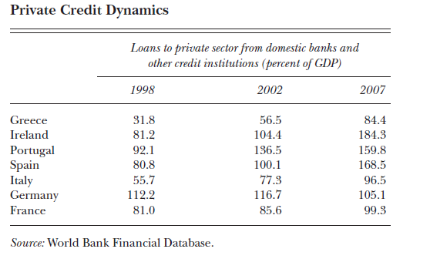
Domestic credit boom
A key predictor of a banking crisis is the scale of the preceding credit boom

Slide 16
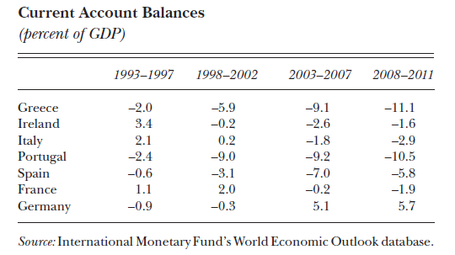
Current account imbalances

Slide 17
Asymmetric impact
The global financial shock disproportionately affected countries with the greatest reliance on external funding
Sharp current account reversals and expenditure reductions between 2008 –2010

Slide 18
Sustainability and the Euro
Fiscal policy became less countercyclical after the euro
For the euro periphery: a major reassessment among investors of the sustainability of credit growth and large external deficits

Slide 19
Public Deficits

Slide 20
Ratings

Slide 21
Multiple equilibria
High sovereign debt can give rise to self-fulfilling speculative attacks
The European Central Bank’s program to purchase sovereign bonds can also be viewed as a way to reduce the risk of the “bad” equilibria

Slide 22
Spreads (Philip R. Lane, JEP, 2012)

Slide 23
European Financial Stability Facility (EFSF)
May 2010: preserving financial stability in Europe
EFSF can issue bonds on the market
provides financial assistance to eurozone states in difficulty.
emissions are backed by guarantees given by the euro area member states in proportion to their share in the paid-up capital of the ECB
November 2011: members agreed to expand the EFSF

Slide 24
European Financial Stabilisation Mechanism
January 2011: emergency funding programme
funds raised on the financial markets and guaranteed by the European Commission
the EU budget is used as collateral

Slide 25
The ECB intervention
Since May 2010:
open market operations buying government and private debt securities, (€219.5 billion by February 2012)
it simultaneously absorbed the same amount of liquidity to prevent a rise in inflation
It reactivated the dollar swap lines with Federal Reserve support.

Slide 26
The ECB intervention
Changes regarding the necessary credit rating for loan deposits.
All new debt issued or guaranteed by the government, is accepted as collateral, regardless of the nation's credit rating.
December 2011, the biggest infusion of credit into the European banking system: €489 billion loans to 523 at 1% rate.

Slide 27
Outright Monetary Transactions
September 2012: additional financial support in the form of some yield-lowering bond purchases.

Slide 28
Fiscal compact
December 2011 all members of Eurozone plus six future members agreed on a reform of the SGP:
strict caps on government spending and borrowing
automatic penalties for those countries who violate the limits.

Slide 29
Eurobonds
November 2011: the European Commission suggested that eurobonds issued jointly by the 17 euro nations would be an effective way to tackle the financial crisis.
matched by tight fiscal surveillance and economic policy coordination
Germany remains skeptical

